Slide 1

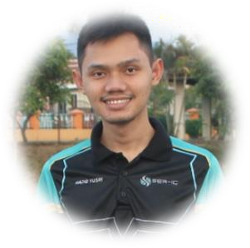







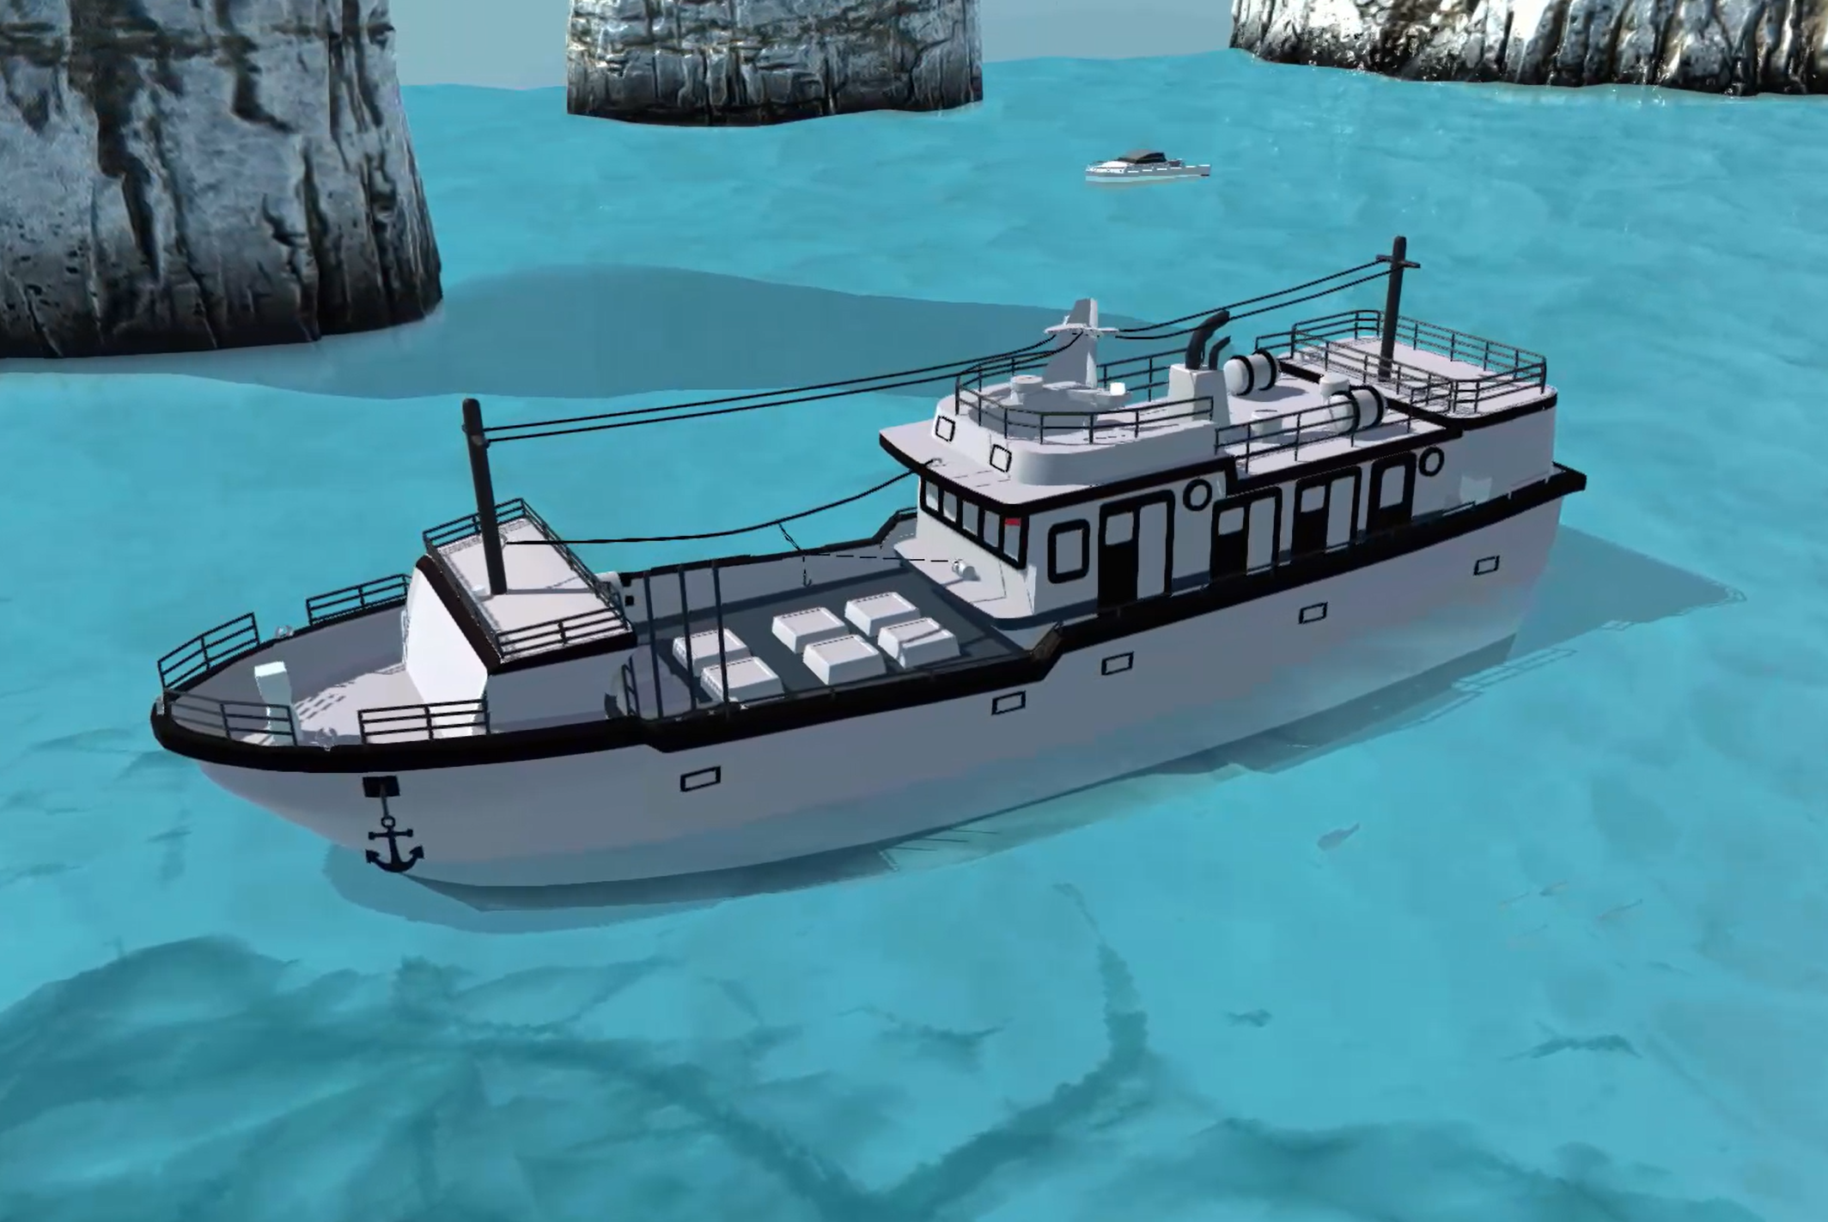
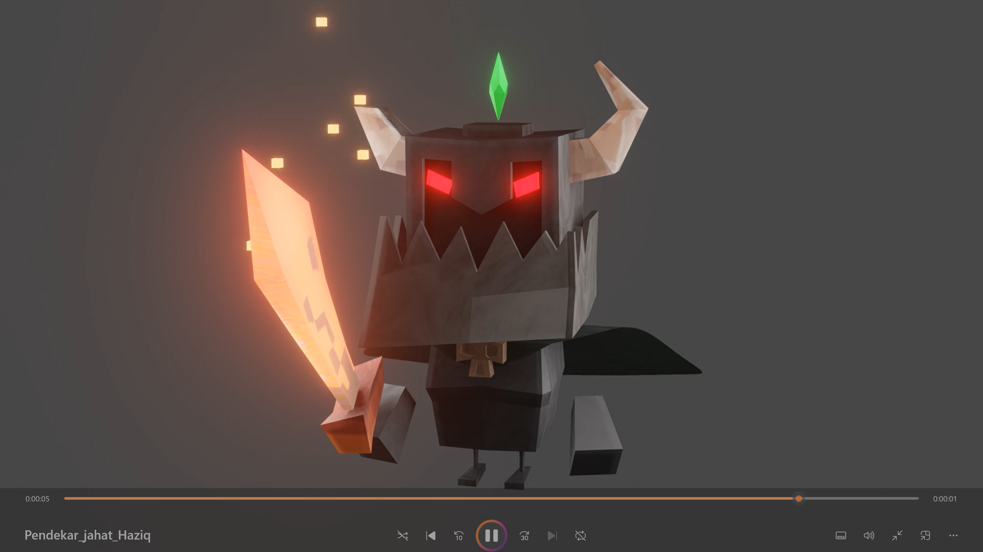
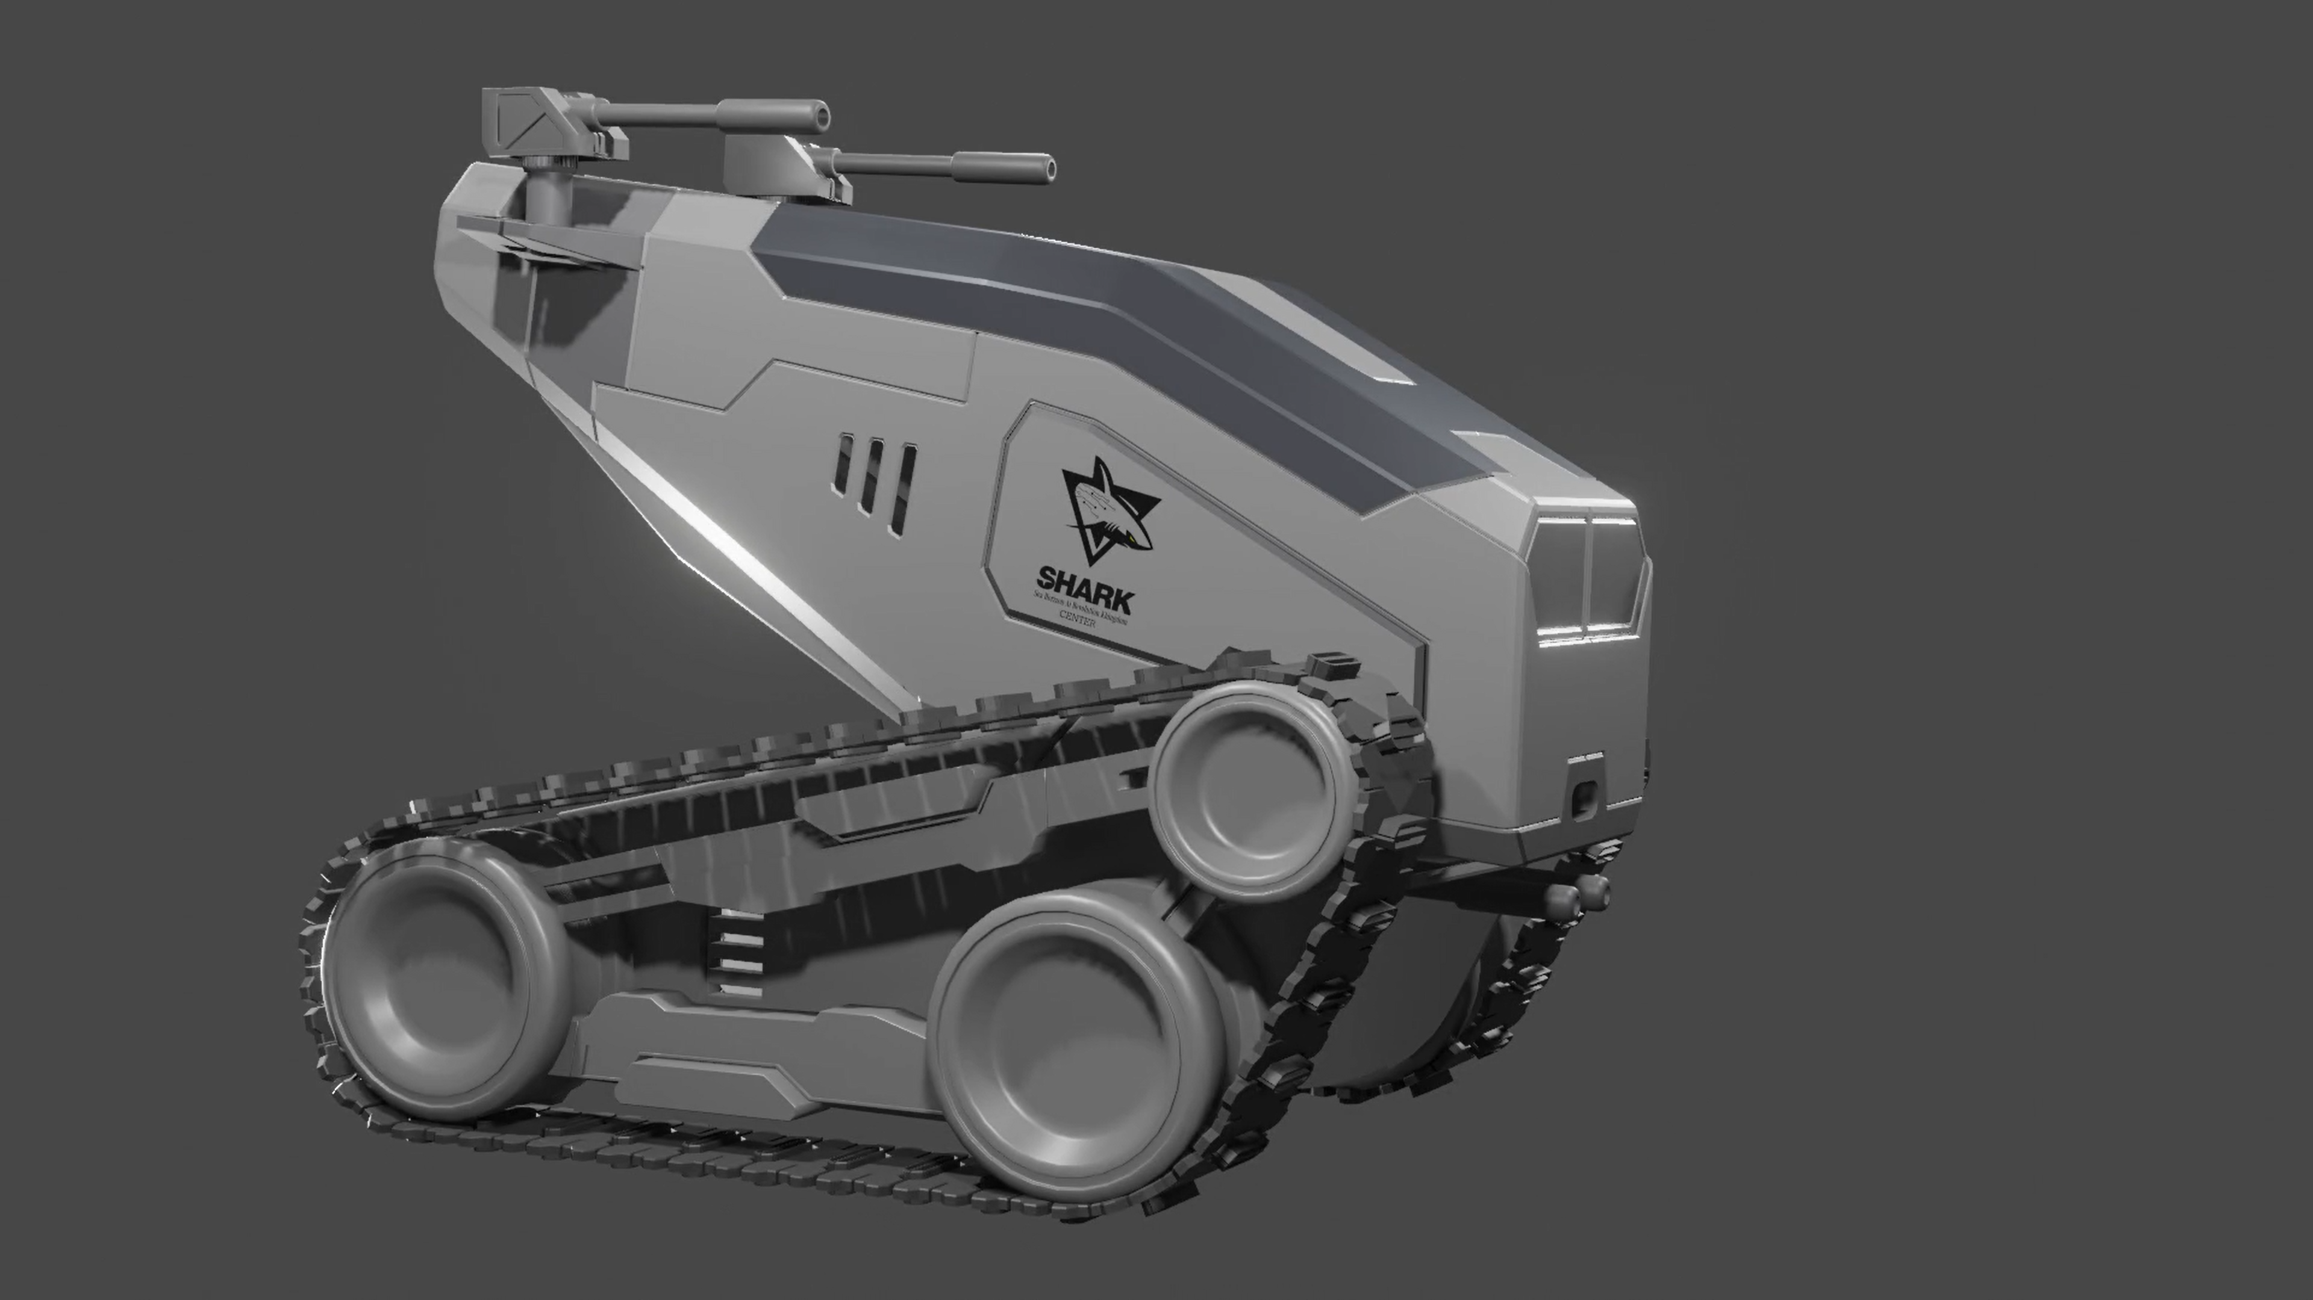
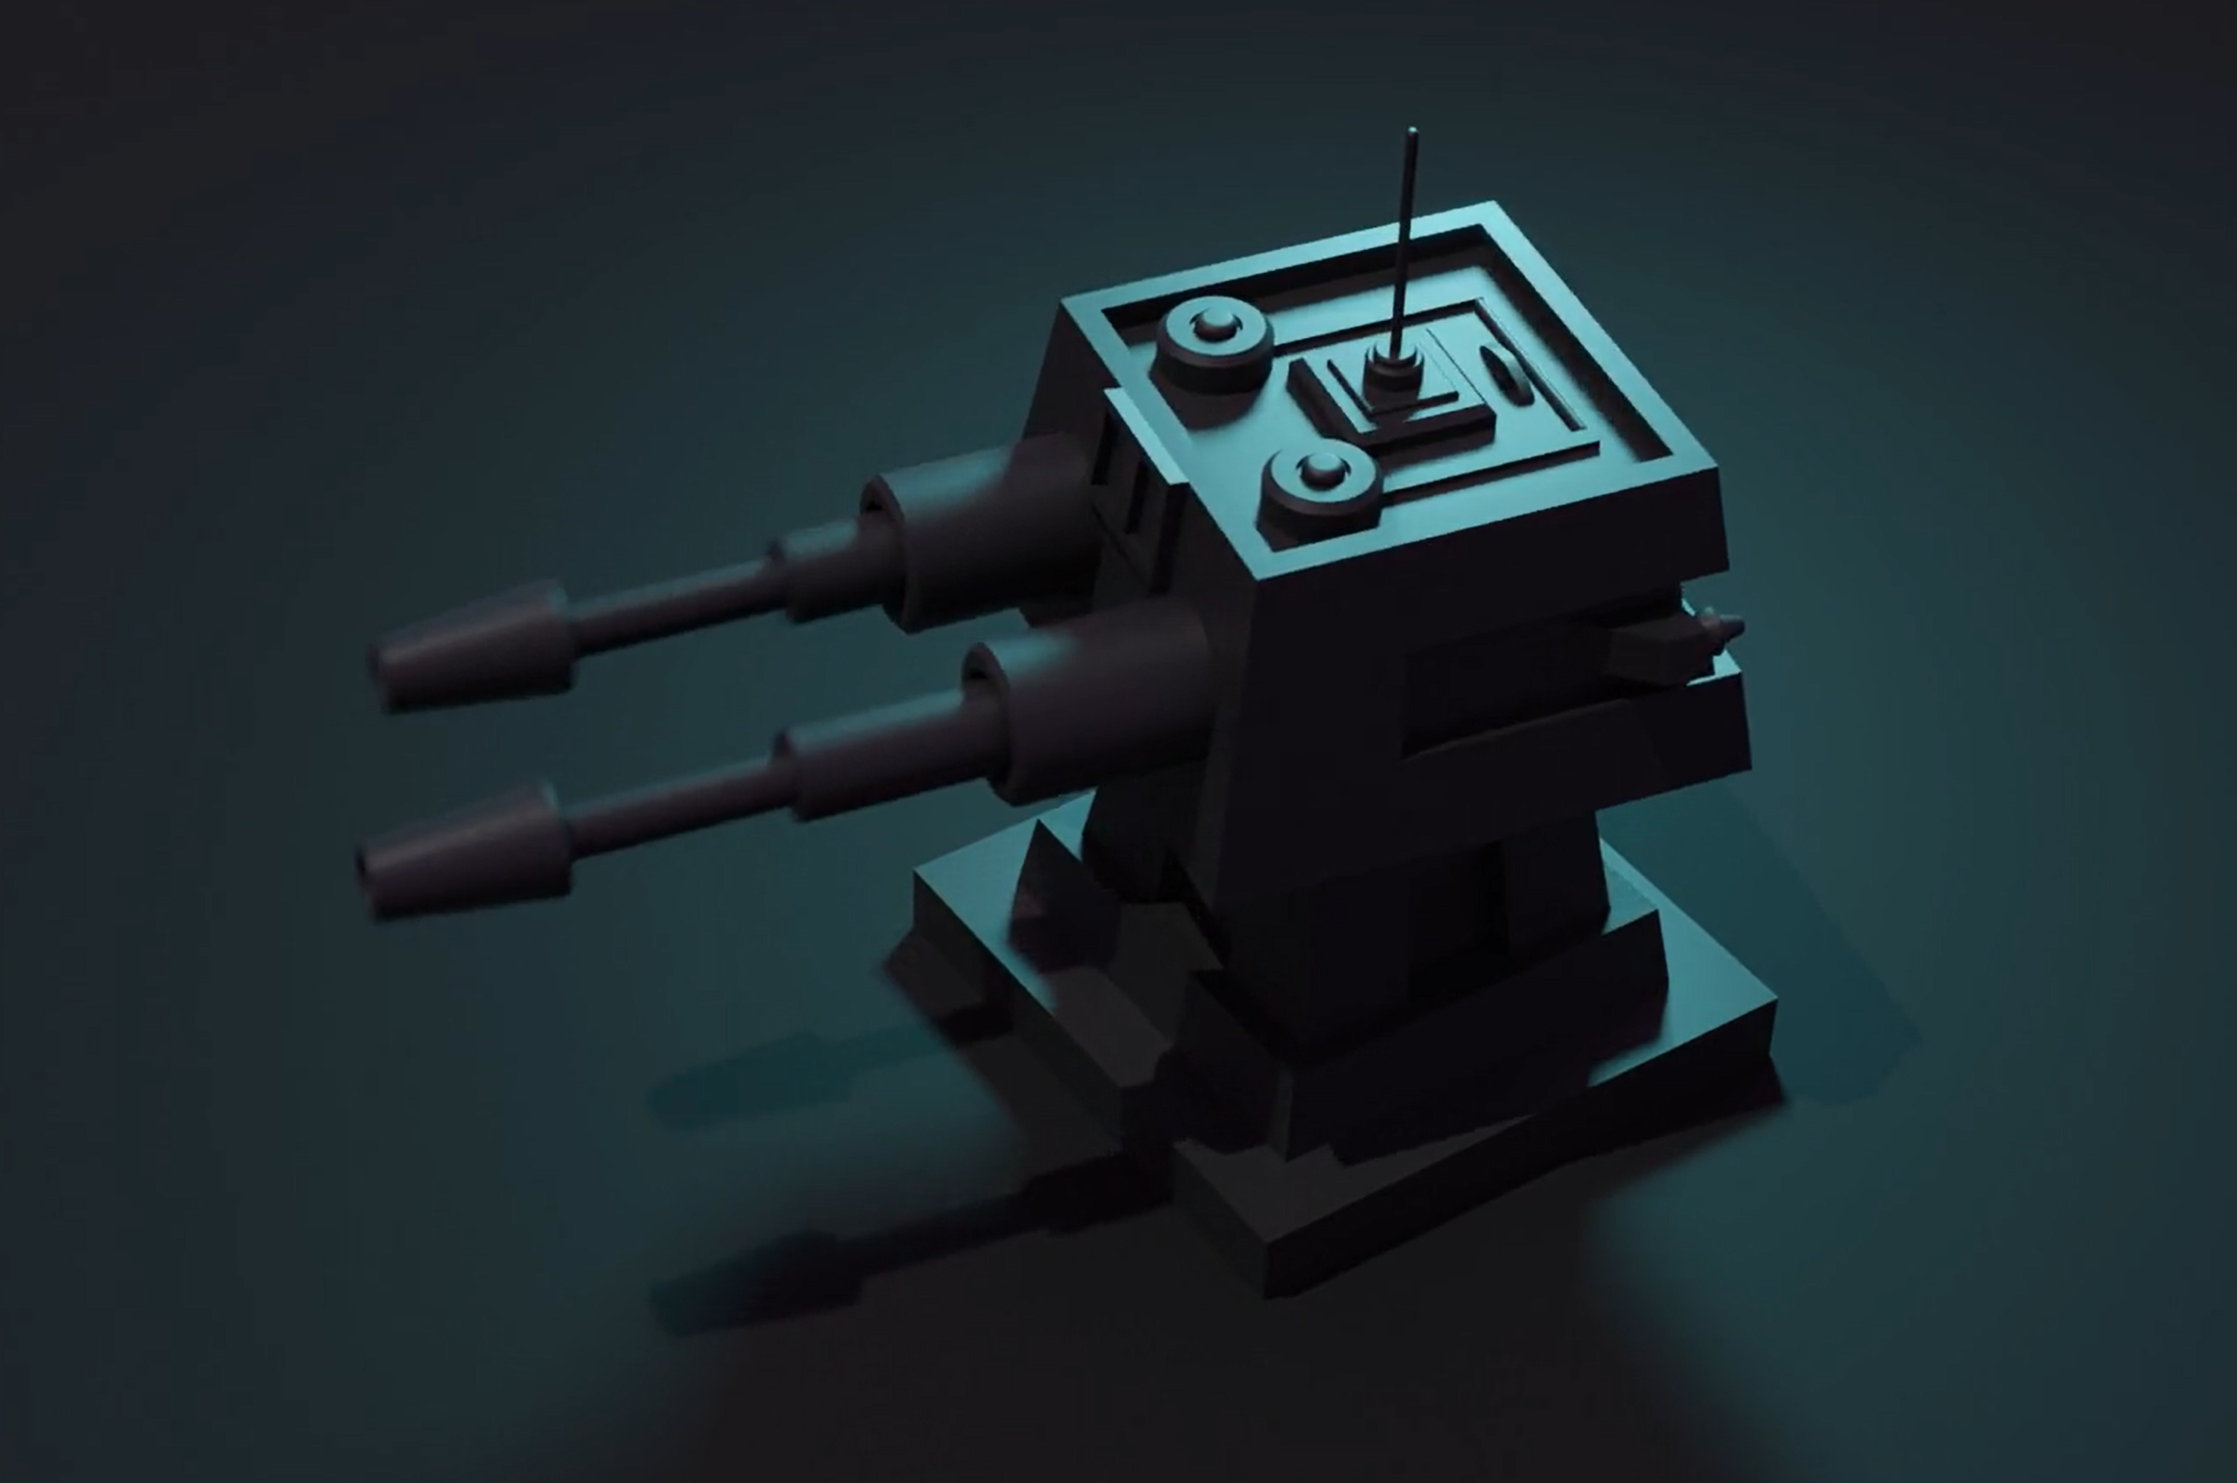
MOHAMAD HAZIQ
AHMAD YUSRI
EDUCATION
2020-2023 Universiti Teknologi MARA (UiTM) Shah Alam Master of Science in Mechanical Engineering (RESEARCH)
DEVELOPER & PROGRAMMER
2015-2019
Universiti Teknologi MARA (UiTM) Shah Alam Bachelor (Honour) of Mechanical Engineering CGPA : 3.65 (First Class Honour)
Universiti Teknologi MARA (UiTM) Puncak Alam
Foundation in Engineering
CGPA : 3.42
MUET : Band 3
SMK Seri Pagi Senawang
Science Account
SPM : 8A 1B
Qualification : LCCI Certificate (Lvl 2)
2014-2015
ABOUT ME
2009-2013
NO111, TTJS 3/7
TMN TUANKU JAAFAR 71450 SEREMBAN NEGERI SEMBILAN
EXPERIENCE
haziqahmad38@gmail.com seasharkcenter@gmail.com
Sport Engineering & Artificial Intelligence (SEA-IC) UiTM
Feb’19 – Current
International Innovation Competition (IINNCOME 2022)
Develop AR in teaching Arabic linguistic terms (Silver Award)
Blender Class
Basic Blender training to SMKA Tun Rahah for 2 days
Provide 3D printing services for their 3D design
MAHA 2022 Project with LKIM
Develop AR apps for exhibition display at MAHA 2022 in the main hall A
Design 2 models: ship and solar dome to display in AR environment
OTHM Qualification (Vivatel Hotel Kuala Lumpur) 23 – 29 August 2020
Provide professional programming tutoring to the participants and also assisting professional lecturers.
Teach them how to resolve software problem (programming).
Research Assistance
Develop an Augmented Reality (AR) platform in marine sector
Develop autonomous UGV using ROS environment
Arduino Class (Hardware and Software)
Provide personal programming class using Arduino for University students.
Provide basic and advance Arduino training to the high school, bachelor and foundation students.
TVET IOT 4.0 (24/2/2020) – UiTM smart classroom
- Provide professional programming tutoring in Industrial Revolutions (IR 4.0) to the senior lecturers.
+6019-2528232
I'm the founder of SHARK company, a trailblazing venture at the forefront of Augmented Reality (AR) and Virtual Reality (VR) technologies. As an entrepreneur driven by a passion for pushing the boundaries of human experience, I embarked on this remarkable journey to transform how we interact with the digital and physical worlds. My fascination with the potential of AR and VR began long before the technology reached its current state. Over the years, I closely followed the evolution of these immersive technologies, eagerly anticipating their transformative impact on various industries. Witnessing AR and VR's fusion of art, science and technology, I was inspired to establish SHARK as a beacon of innovation and creativity, especially in enhancing education system.
SOFTWARE SKILLS
PROGRAMMING : C# + C++
PROGRAMMING : PYTHON
PROGRAMMING : HTML + CSS + JS
3D DESIGN (BLENDER)
AUGMENTED REALITY (AR) - UNITY
LANGUAGES
PROJECTS
MALAY
ENGLISH

Slide 2
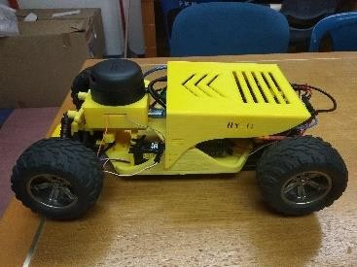
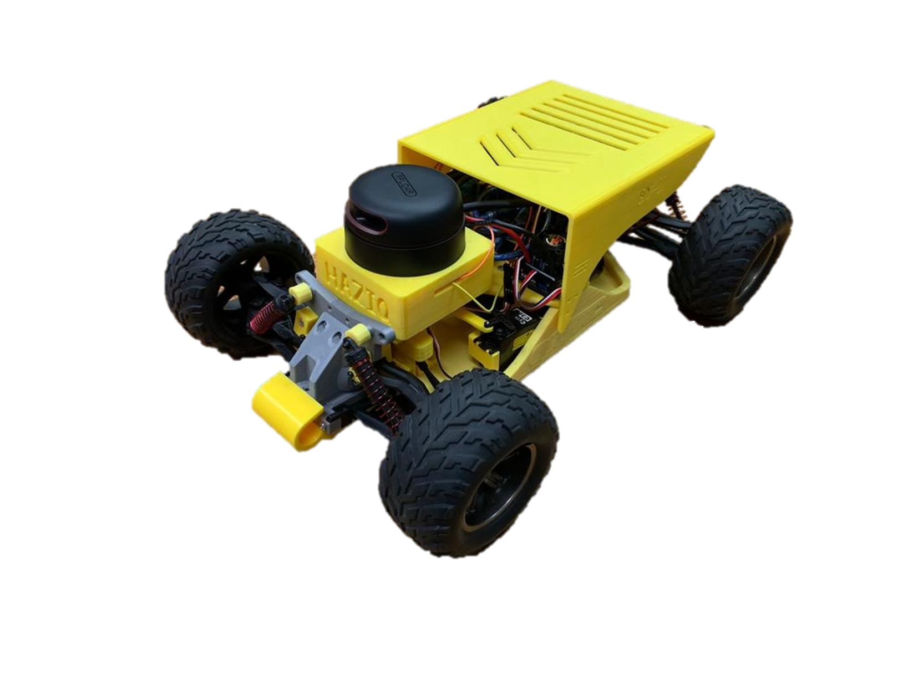
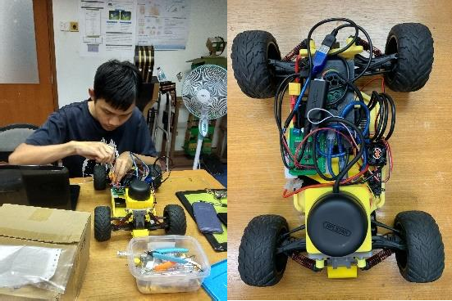
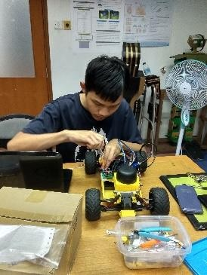
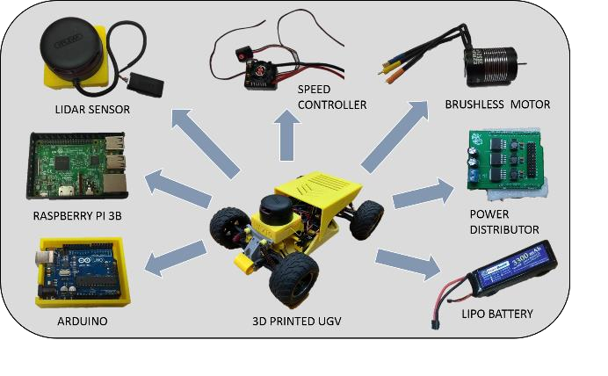
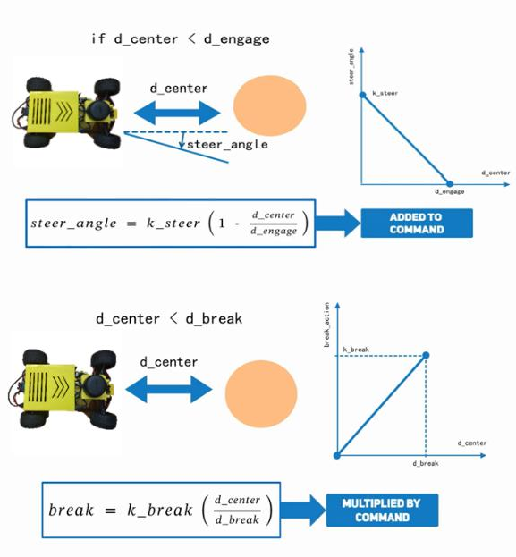
PROJECT 1
AUTONOMOUS NAVIGATION FEATURE ON UGV USING ROBOTIC OPERATING SYSTEM (ROS) ENVIRONMENT
INTRODUCTION
This project presents a study, focuses on the use of a Robotic Operating System (ROS) environment to manage and control the motion characteristics. The combination of LiDAR sensor and Raspberry Pi 3B microcontroller enable the UGV to sense and decide the task with better accuracies, e.g., avoid objects and obstacles while performing prescribed navigation tasks. In order to verify the effectiveness, several assessments are designed and put to the test.
DEPLOYMENT
The overall overview of the deployment of the logistic management system is illustrated by the following stages.
Stage 1: Design prototype model of UGV
Stage 2: ROS environment setup in Raspberry Pi on Ubuntu OS Stage 3: ROS communication applications
(Publisher, Subscriber, Topics)
Stage 4: Electronics and power distribution setup Stage 5: Programming Ecosystem deployment
The design of heavy-duty chassis for the UGV process is done by using CATIA software. Then, the prototyping process is facilitated by 3D printing technology and almost 80% of the UGV parts are printed including gears using Polylactic Acid (PLA) material type. The mechanical design of the UGV focused on sustaining heavy loads and abrupt changes during accelerating and braking.
The major part for the UGV is the power supply. The 3 cells battery that contain 11.1V, and 3300mAH is used to distribute the power to all electronic devices equally using power distributor. Power distributes as follow:
Raspberry Pi 3B : Operates at 5.2V and 1.35A
RP LiDAR A2 ESC
Arduino
: Operates at 5.0V and 1.50A
: Operates at 11.1V and 45A (max)
: Power supply from Raspberry Pi 3B
Next, to manoeuvre the UGV automatically, the UGV needs decision maker that will calculate the steering angle, and avoid from colliding with the obstacles. Therefore, simple drive formula has been applied into the system by manipulating the incoming data from the LiDAR sensor.

Slide 3
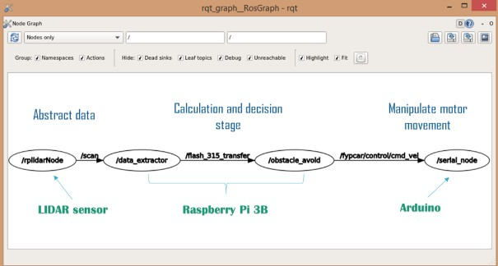
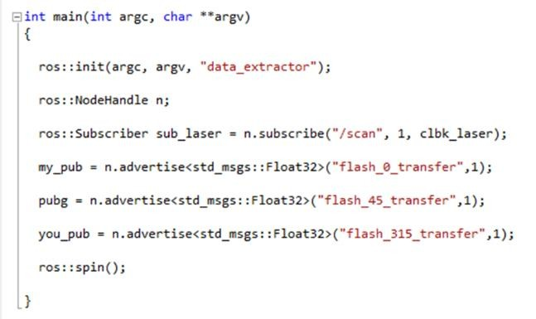
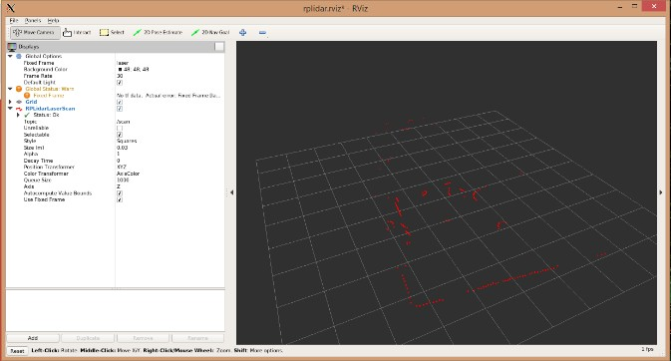
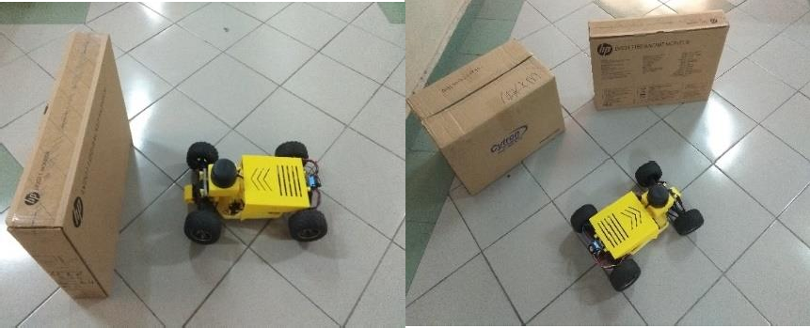
PROJECT 1
AUTONOMOUS NAVIGATION FEATURE ON UGV USING ROBOTIC OPERATING SYSTEM (ROS) ENVIRONMENT
ROS NODE FLOW
Next, the UGV is setup using the following node flow structure :
Extract data from the LiDAR sensor
Apply decision maker formula
Calculate and Estimate the surrounding distance
Give command to the motor via Arduino
These structure are deployed on ROS environment
CODING
In this UGV system, python and C++ programming architecture are used in ROS environment. There are 4 ROS nodes structure with different type of programming languages applied for each section. The LiDAR node will publish the data in form of distance and angle for every 1 degree of rotation. Then, decision maker node will subscribe the LiDAR node and estimate the movement speed and direction for the UGV. Lastly, the speed data will be sent to the Arduino to move the motor.
DATA INPUT
Rviz framework displayed the data points obtained from the LiDAR sensor. The points are plotted in 2D cartesian plane and form point clouds mapping. These points show the obstacles surround the UGV and the distance between them. Therefore, with these data, the system can decide a safe path to manoeuvre until reach the destination point.
FIELD TEST
The UGV is successfully tested running on the hallway with 2 boxes as obstacles. The UGV stop moving when there are suddenly object appeared that block its path. But, if the object is static, the UGV will automatically change directions to avoid from colliding.
Get more details about this project here

Slide 4
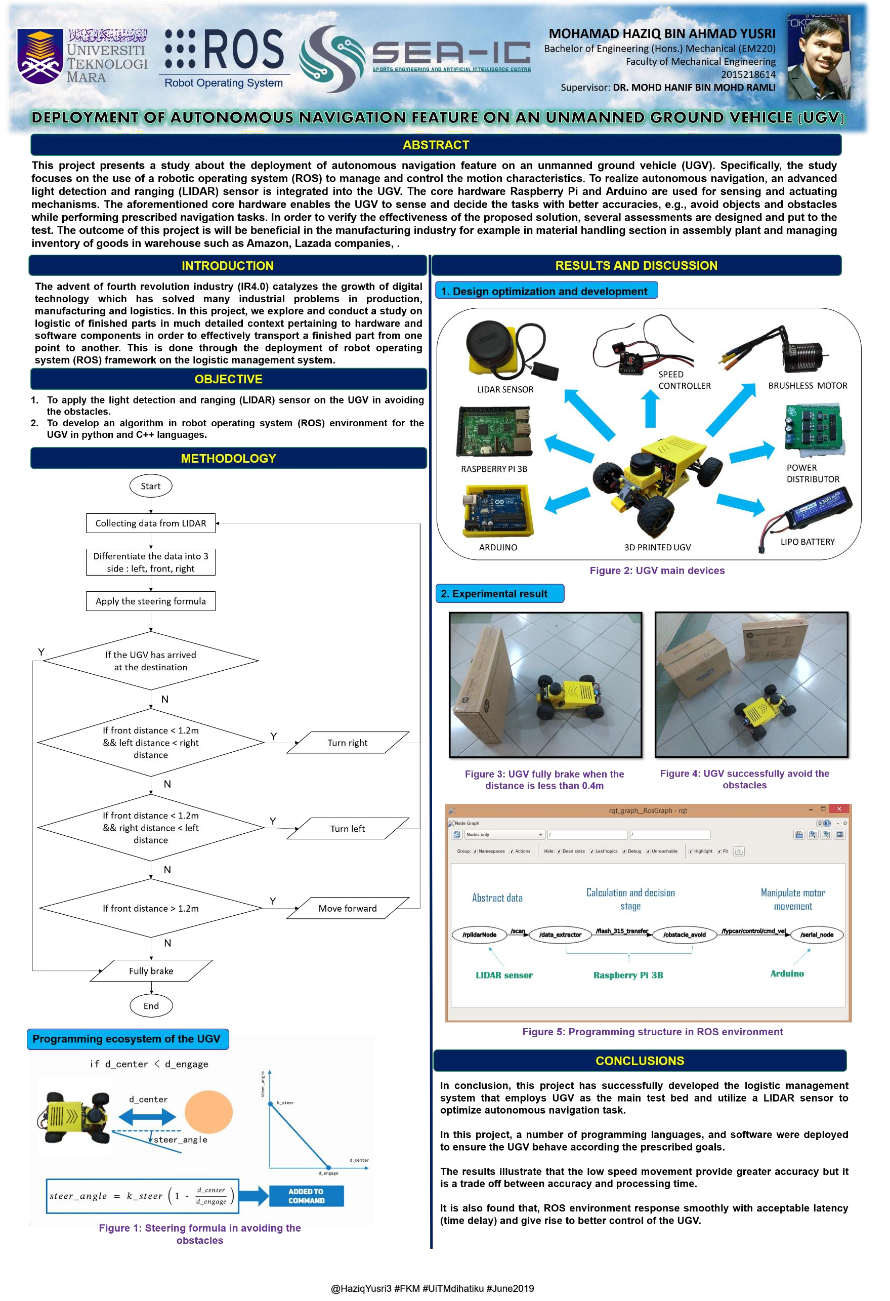

Slide 5
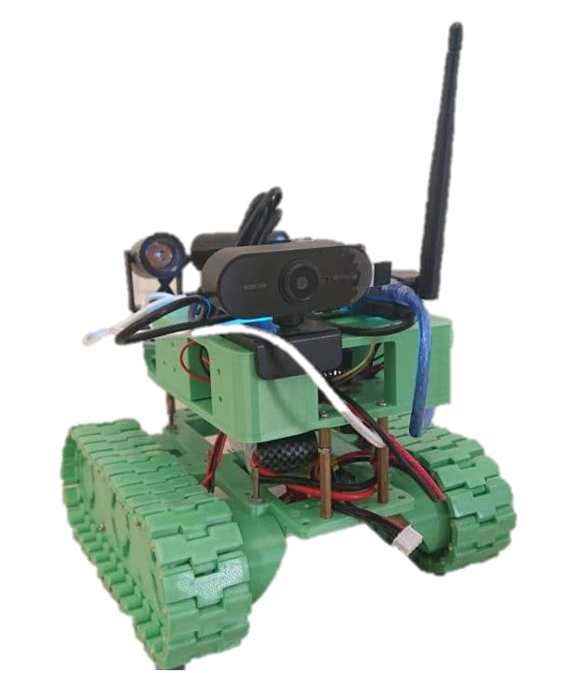
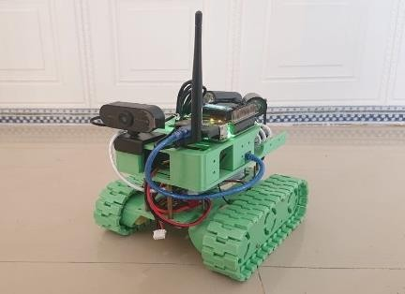
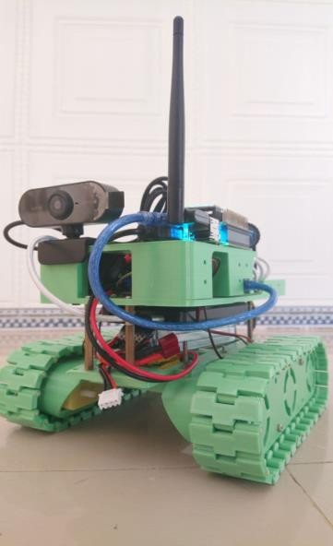
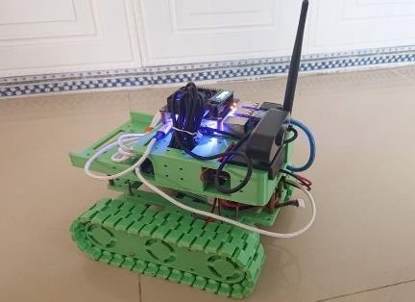
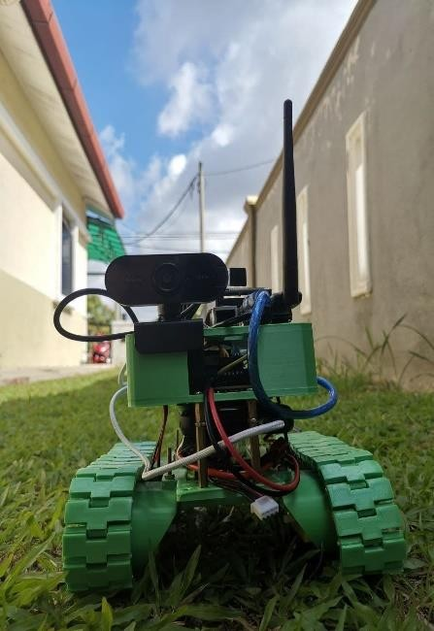
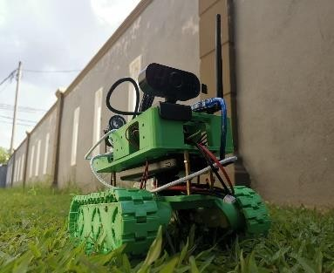
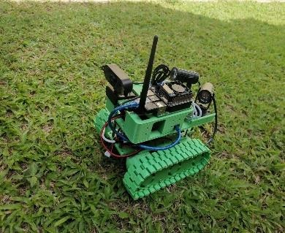
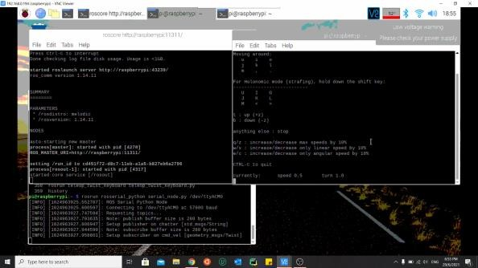
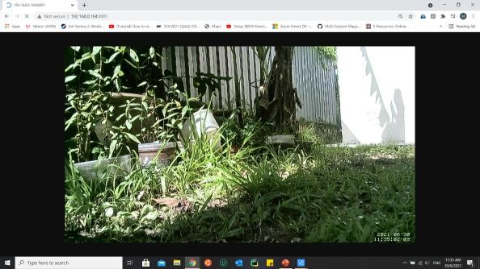
Air Quality Monitoring using Surveillance Ground Vehicle (SGV)
PROJECT 2
INDOOR TESTING
This SGV is a hobby project during lockdown due to the pandemic of Covid 19. The objective of this robot is to monitor any activities that happened inside and outside the house. In the same time, this robot is equipped with humidity and 𝐶𝑂₂ gas sensor to observe the indoor and outdoor air quality. While, for the microcontroller, Raspberry Pi 3B+ is used as a main controller to control the motor and received the sensors data via ROS environment. The simple programming of C++ is used to link up the motor and the laptop keyboard together.
OUTDOOR TESTING
This SGV is controlled via keyboard command to manoeuvre around the house. It can go as far as the SGV connect with the home WIFI network. If the SGV move outside the WIFI signal range, the user cannot control the SGV until the signal comes back. Therefore, to increase the WIFI range, WIFI antenna is used as a WIFI extender.
The body kit of this SGV is designed in CATIA and printed using PLA material. The SGV is powered by Power Bank and 2200 mAH LiPo battery to power up 4 DC motors and Raspberry Pi 3B+.
ROBOT VISION

Slide 6
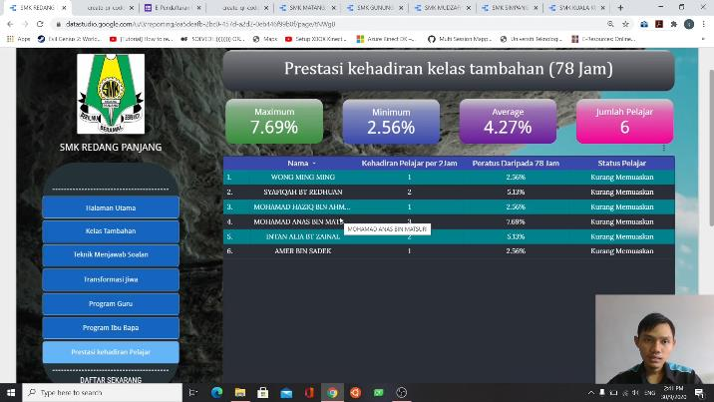
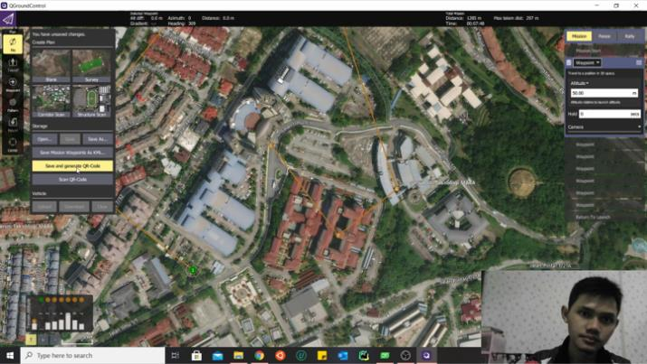
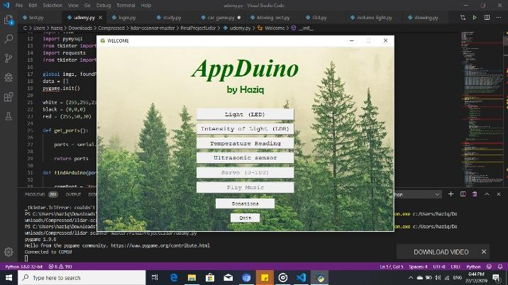
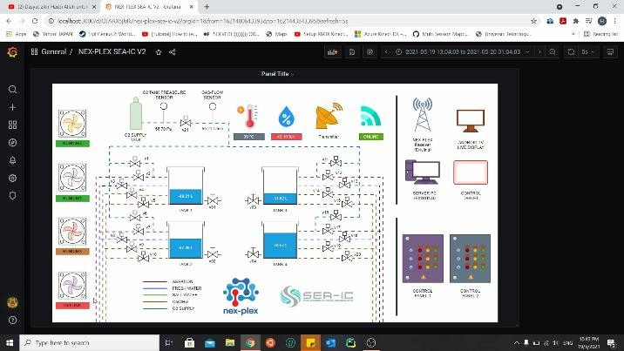
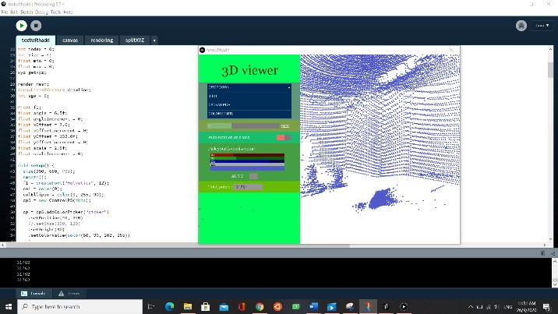
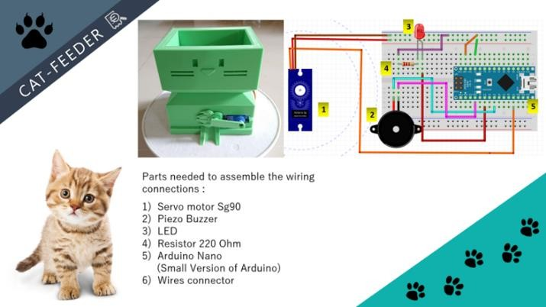
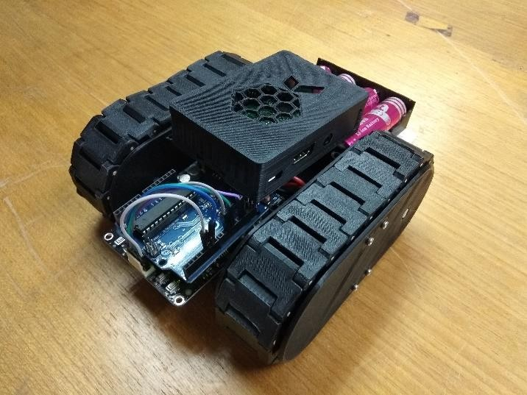
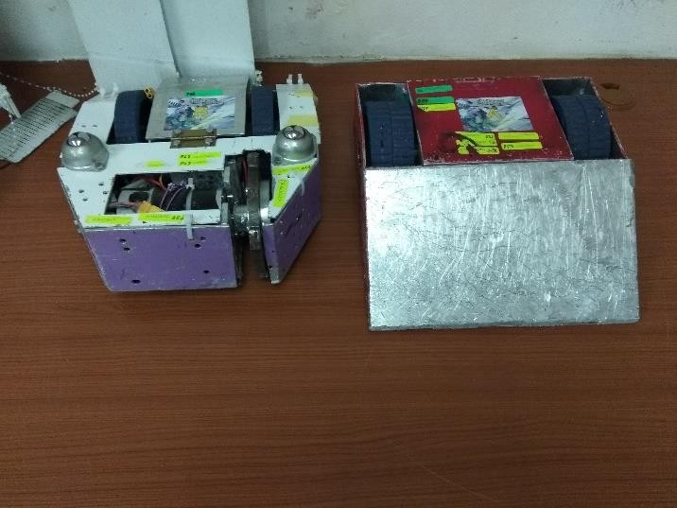
OTHER PROJECTS
Develop Dashboard for SMK Redang Panjang
Adding QGroundControl (QGC) features
Develop GUI for Arduino Interface
Develop IoT Monitoring Dashboard
Develop GUI for 3D View for point clouds using Processing software
Develop Automatic Cat Feeder for Arduino Course
Develop Simple Mini Tank
Controlled by Raspberry Pi
Develop Combat Robot
For Competition

Slide 7
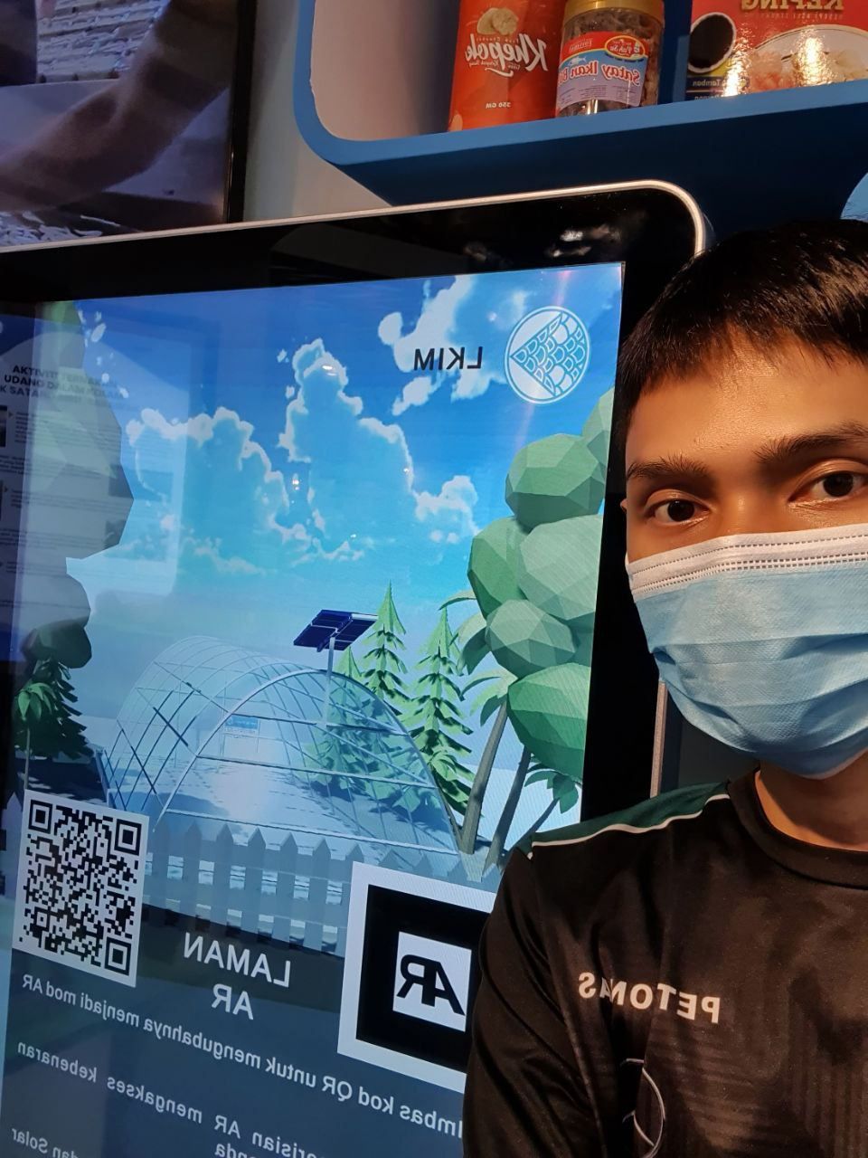
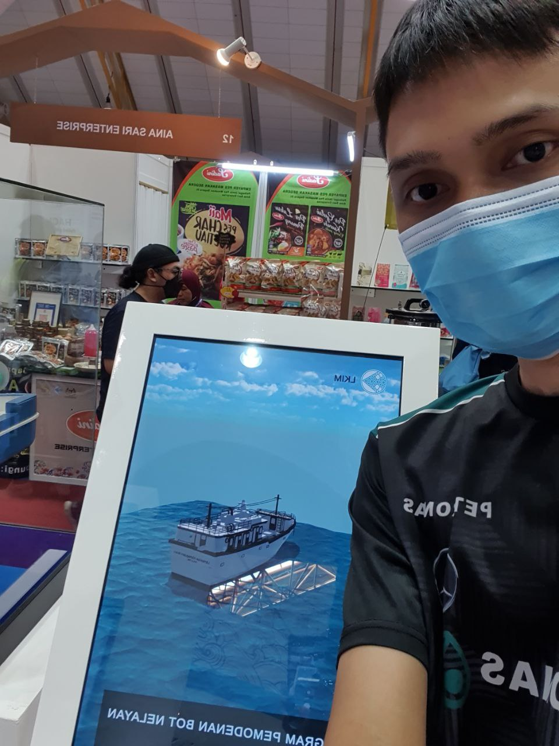
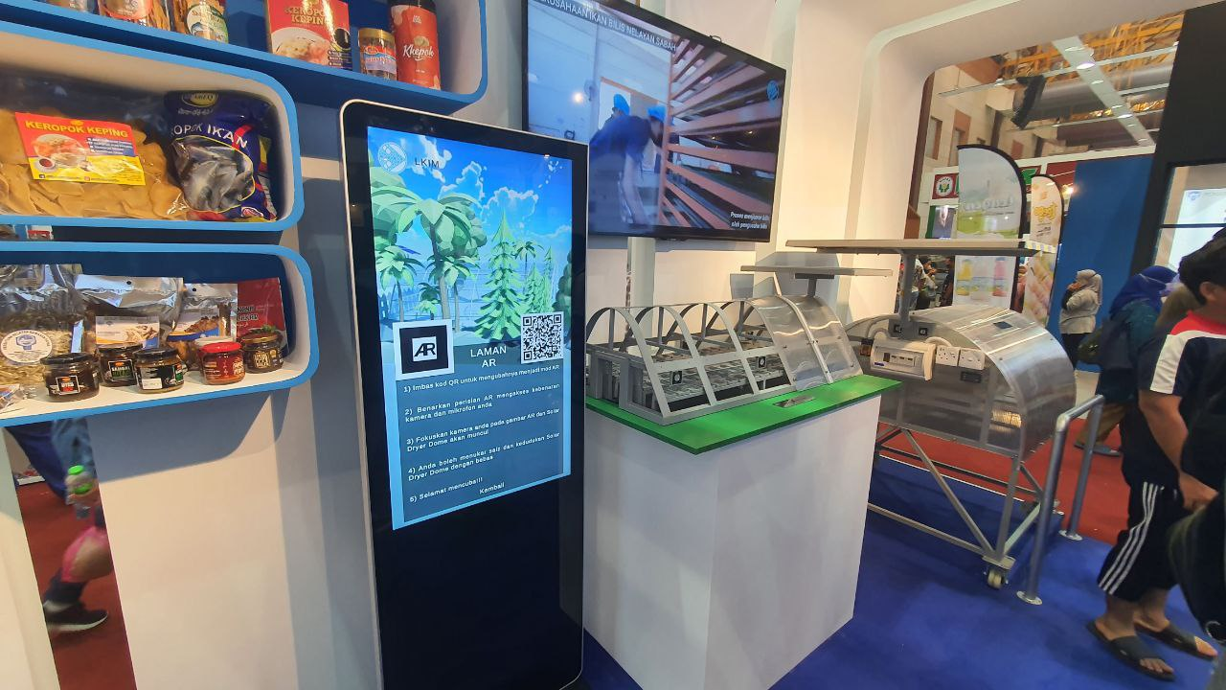
MAHA 2022 PROJECTS
Solar Dome dashboard
displayed in hall A
Modern Ship dashboard
displayed in hall A
MAHA 2022 display area

Slide 8
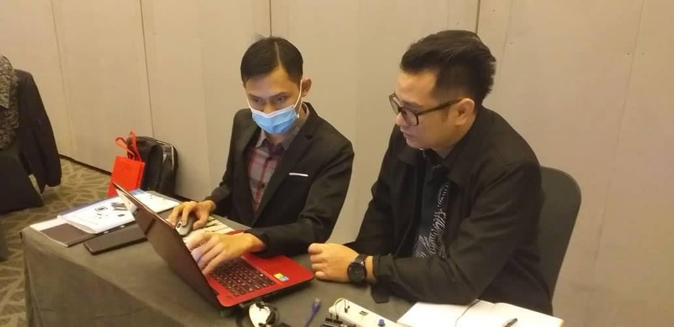
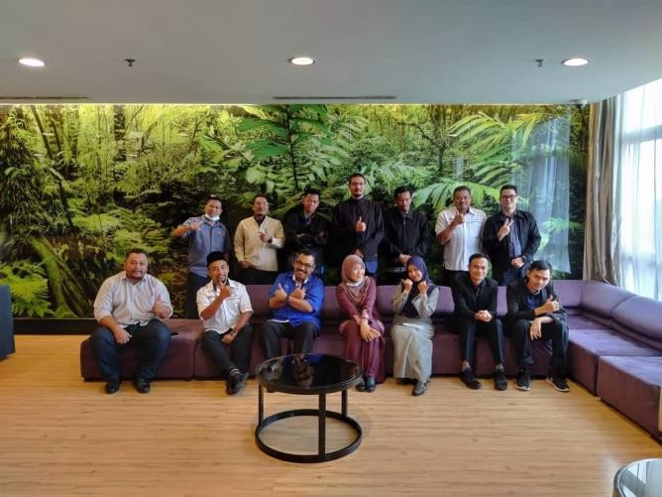
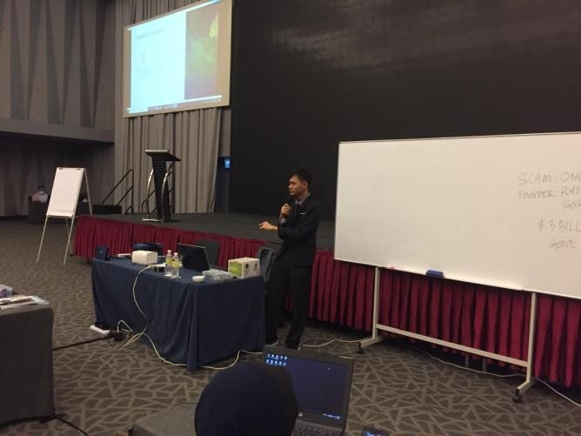
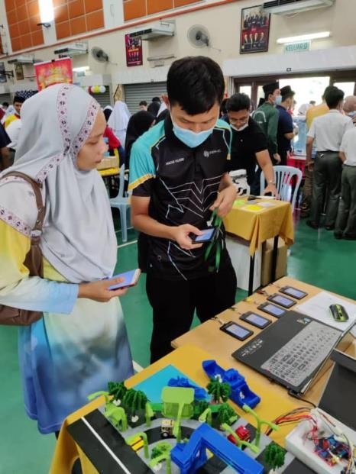
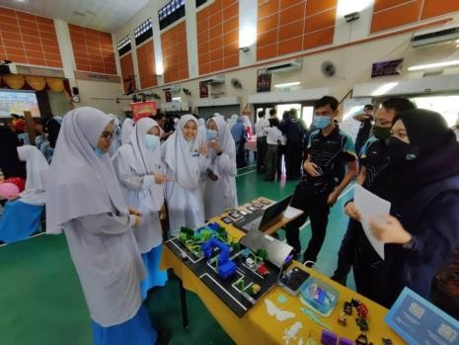
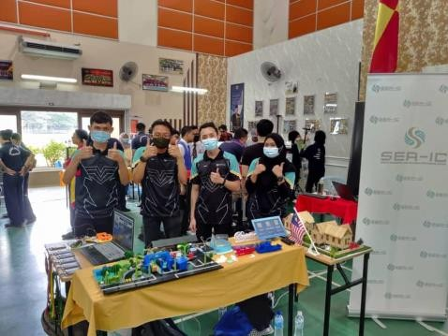
ACTIVITIES AND ACHIEVEMENT
OTHM Qualification
Venue = (Vivatel Hotel Kuala Lumpur) Date = 23 – 29 August 2020 Summary :
Provide professional programming tutoring to the participants and also assisting professional lecturers. Teaching them how to use Raspberry Pi as a medium for Internet of Things (IoT).
Science and Technology Festival Venue = SMK SEKSYEN 14
Date = 10 November 2020
Summary :
Demonstrating the benefits Internet of Things (IoT) program to the students and teachers. Then, expose to the students with current technology such as home automation, 3D printing, and robotics.

Slide 9
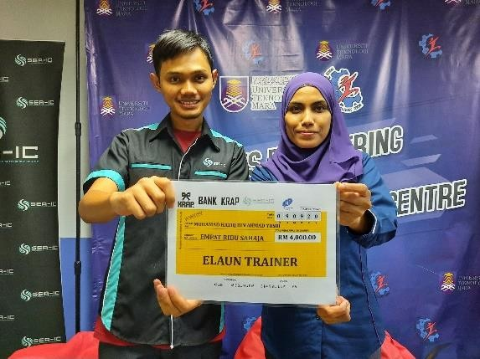
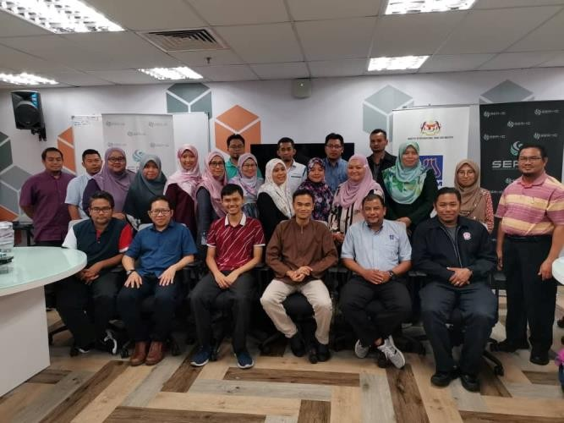
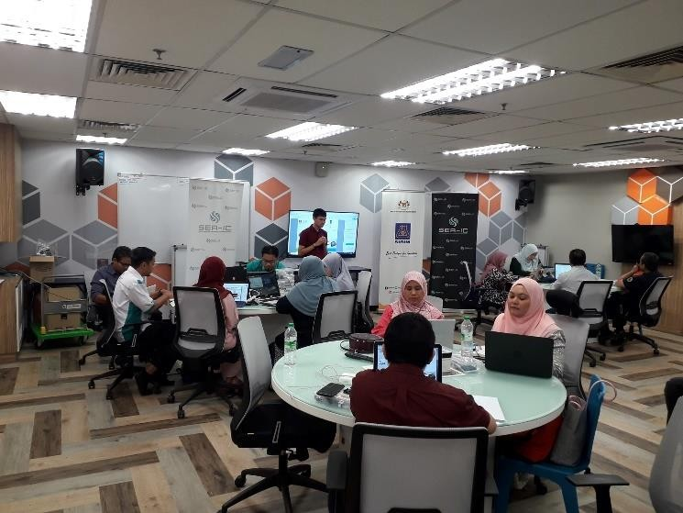
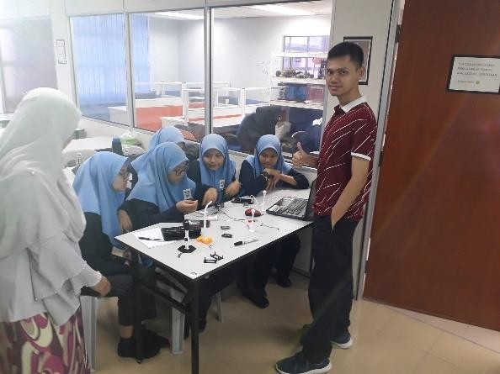
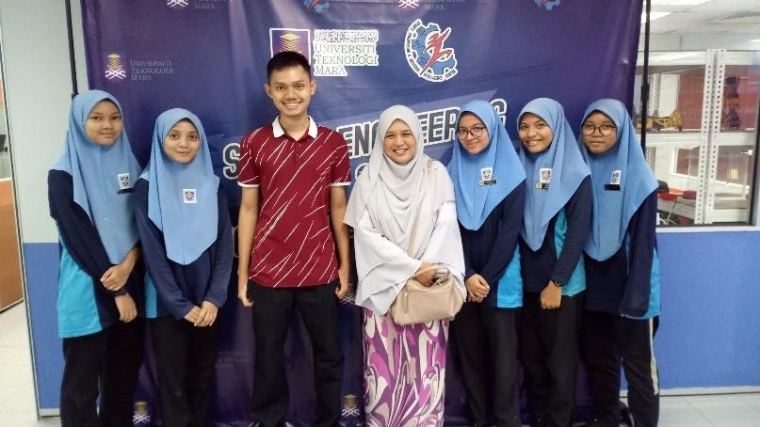
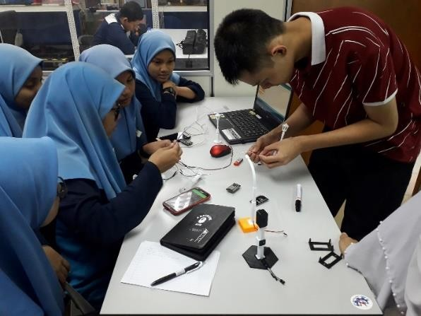
ACTIVITIES AND ACHIEVEMENT
Custom Hands On Integrated IoT Project for Industrial Application
Venue = UiTM Shah Alam (Smart Class Room)
Date = 24 - 28 February 2020 Summary :
Provide professional Internet of Things (IoT) training to the participants and assisting professional lecturers. Increase their understanding about coding structure and behaviours.
IOT Tutoring
Venue = UiTM Shah Alam (SEA-IC) Date = 04 November 2019 Summary :
Provide personal tutoring to team SMK Sungai Buloh before entering the National Innovation Competition. They won a trophy for 2nd place in the competition.

Slide 10
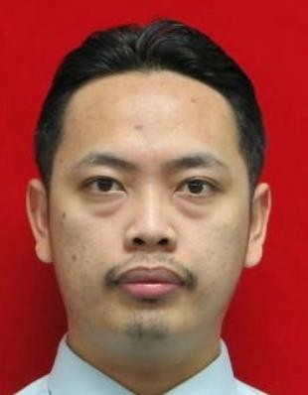
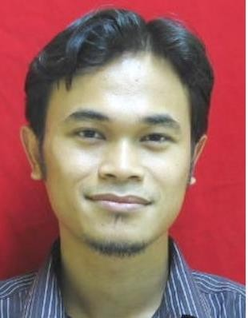


REFERENCES
Zulkifli Mohamed (Ts. Pm. Dr.)
Faculty of Mechanical Engineering UiTM Shah Alam
Position = Senior Lecturer
Company = Sport Engineering & Artificial Intelligence (SEA-IC) (Founder & Head of SEA-IC)
TEL = 010-6051919
Mohd Hanif Mohd Ramli (Dr.)
Faculty of Mechanical Engineering UiTM Shah Alam
Position = Senior Lecturer
Company = Sport Engineering & Artificial Intelligence (SEA-IC) (Founder & Programmer of SEA-IC)
TEL = 011-62747554

